Slide 1

The vagrantfile

Slide 2
The vagrantfile

Slide 3
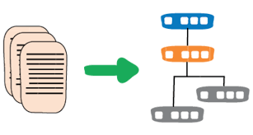
The infrastructure manager
In the last section of the intro here we went deeply into the advantages of keeping your infrastructure as code…so let’s take a quick look at how to do that practically:
The Vagrantfile is the first and best example of how code can create and maintain infrastructure in a development environment.
The syntax of the Vagrantfile is written in RUBY but fear not! You do not need to know Ruby in order to utilize the Vagrantfile.
This section will be dedicated to going over several sections of the Vagrantfile in order to make everyone here Vagrant-provisioning machines!

Slide 4

Vagrant in your file directory
So- when we begin a Vagrant project the first thing we do is create a directory from which we want to run all things vagrant. USUALLY this is a directory with application code already in it and ready to go.
Go ahead and do that now… create a directory called C:\Users\Administrators\vagrantmodone
(Bonus points if you do this from the git bash command line with the mkdir command)

Slide 5

Vagrantfile intro (continued)
The second step is to run the command vagrant init from our command line from within that directory. This will make a Vagrantfile appear (as if by magic!) in your chosen directory. That Vagrantfile will be the primary target of your editing and will have a long list of default settings for you to update in order to create your machine effectively
vagrant init

Slide 6

So what just happened?
So basically you should have seen two things appear in your directory when you typed in vagrant init:
A Vagrantfile appeared and
A .vagrant/ directory appeared (hidden because of the “.” in front
When we want to create or destroy a Vagrant directory we should delete both of these entries

Slide 7

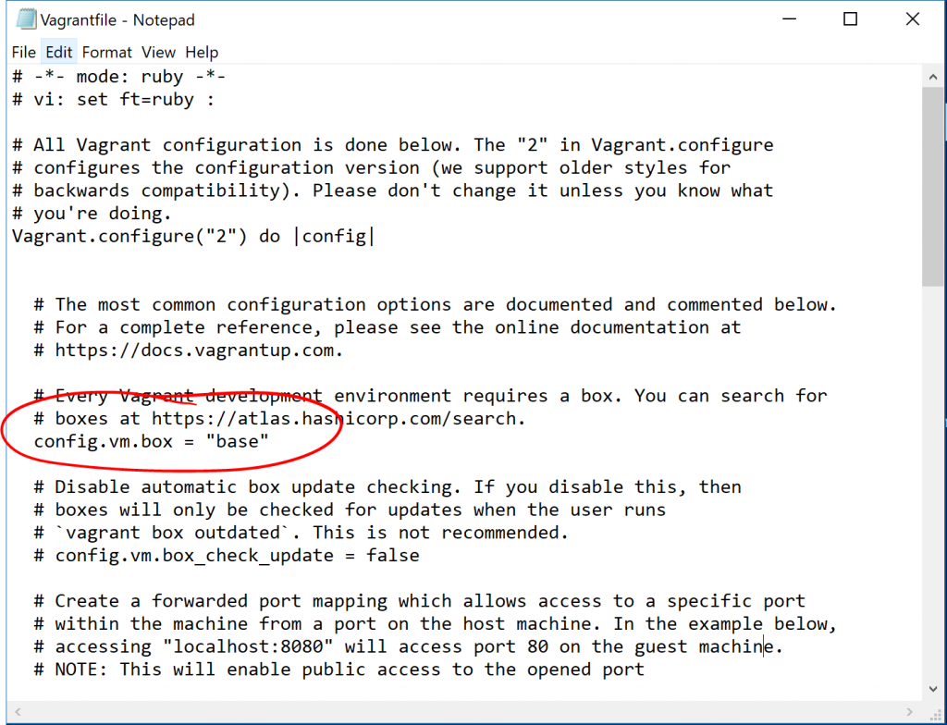
Vagrantfile intro (continued)
The third step is to go INTO your Vagrantfile and edit it to what you would like
This means:
Open up the file finder
Navigate to your new directory
Highlight the Vagrantfile and
OPEN WITH Notepad

Slide 8
Vagrantfile intro (continued)
SO- in this Vagrantfile the first thing that we notice is that it starts with THIS line:
Vagrant.configure("2") do |config|
# ...
end
So what does this mean? Basically
“2” is the version
and the |do| is a bit like starting a loop…in other words “please DO everything that follows!”

Slide 9

Vagrantfile commands (continued)
Now- we can see that there is a large section of text commented out that follows the configure line. This is useful for helping beginners to understand what is happening in the Vagrantfile but is not strictly necessary.
Read through the comments and then delete them IF YOU WISH (personally…I find less cluttered code easier but this is a 100% personal preference!)

Slide 10

Vagrantfile: Config.vm.box
There are numerous settings that we can put in this section. If you have a default Vagrantfile right now it should just say config.vm.box=“base”
This is where you will identify the image of the machine that you want to use to create your VM….
SO- as we will be seeing in the upcoming lab- THIS is where you will be putting things like “CentOS” or “Ubuntu” or “Windows” depending on which box you want to use.
THIS entry forms the base Operating system of our virtual machine.

Slide 11
Config.vm.box (continued)
config.vm.box is basically where we would POINT TO the image we want to use.
By default it is set to point to the Hashicorp Vagrant Cloud images found at https://app.vagrantup.com/boxes/search
BUT- if you have a box located somewhere else you can change this to config.vm.box_url
This means that if you have an .iso image in, say, a DROPBOX or GIT repo you can drop that link in here and Vagrant will download THAT image
99% of the time I’d recommend just using the hashicorp site though…

Slide 12
Config.vm.box (continued)
There are a bunch of other variants of config.vm.box that we can go through, including but not limited to:
config.vm.box_download_checksum
config.vm.box_download_checksum_type
config.vm.box_download_ca_cert
etc,etc
That is really advanced stuff though and basically all deals with HOW Vagrant will get the image to load up (should it check the ssl encryption? That sort of stuff).
Basically the big takeaway here is that config.vm.box is all about pointing Vagrant to which image it should use to make your virtual machine

Slide 13
config.vm.box_check_update
The next commented out section is config.vm.box_check_update.
Basically- when you run the vagrant up command the first thing that Vagrant will do (in the background) is check to see if there is an update to your box available. NOW- it is possible to adjust this setting to NEVER download and use that update if you want to maintain your machine at it’s current state.
There might be some situations when you want to do this (though I can’t think of any!) so the option is there…but I highly recommend that you leave this part commented out unless you understand the implications of never updating your current virtual machine.
By default “check_update” is set to TRUE

Slide 14
config.vm.network "forwarded_port", guest: 80, host: 8080
This next section deals with how you want Vagrant to treat the relationship between the ports on your virtual machine with the ports on your host machine.
Basically…let’s say you have a Windows web server running a Vagrant CENTOS machine.
You put a bunch of your code onto the Vagrant CENTOS machine that will display pictures of the GOLANG GOPHER on the web
The issue is that there is no BROWSER in your CENTOS machine….but BY GOLLY you want to see your gopher. So what do you do?
You can direct Vagrant to override your PORT 8080 on your HOST machine with whatever is being sent through port 80 on your VAGRANT machine
Now you can open up localhost:8080 on your HOST machine and voila! Pics of GOPHERS galore!

Slide 15
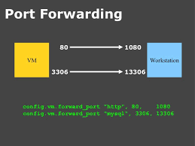
Vagrant port forwarding

Slide 16

Vagrant port forwarding (continued)
The important takeaway here is that Vagrantfile Port forwarding allows your Vagrant machine to essentially “take over” the port of the host in order to do anything from allowing MYSQL commands to be run inside the vagrant machine (via port 3306) to showing web content through port 80.
This is a way to give you direct access to programs INSIDE the vagrant machines FROM your host machine (which, if we’re honest, is probably the machine that actually has most of your CODE GUIs and key programs).

Slide 17

Vagrant port forwarding (continued)
Another important thing to note is the difference between the PRIVATE NETWORKING port forwarding and the PUBLIC NETWORK port forwarding.
ESSENTIALLY here’s the situation:
You have a webserver in the cloud that is currently serving web content to the internets
On this webserver you are running a Vagrant machine that is doing most of the heavy lifting

Slide 18
Port forwarding (continued)
There are three types of port forwarding that you can do from this web server to your Vagrant machine:
Straight up forwarded port mapping (the first option in the Vagrantfile) which gives the outside world access to your vagrant machine
Host only port mapping (second option in the Vagrantfile) which basically says “only IP address 127.0.0.1 (or “localhost”) is allowed to access the Vagrant machine through port 80/3306/5432/443…whatever
Host only port mapping through designated IP address- So maybe you want to designate an IP address OTHER than 127.0.0.1 (like a ”10.” or “192.” or “172”)
Open to the entire world: Basically like a 7-11: Open 24/7/365 and allow anyone and everything through all ports into the virtual machine; in essence treat it the same as the host machine

Slide 19
Port forwarding
Essentially the config.vm.network section of the Vagrantfile is capable of doing a LOT more than just simple port forwarding! BUT…port forwarding is one of it’s primary uses.
Consider though- that through the config.vm.network setting we can:
Network our Vagrant machine with a second Vagrant machine via a private network or public network (we’ll be doing this in module 3)
Create a public network to allow full accessibility
Limit access to your Vagrant machine from the outside world

Slide 20
Config.vm.synced_folder
So the config.vm.synced_folder will allow your vagrant machine to “mount” files from the host machine and make them available on your Vagrant Machine at all times.
This is extremely powerful in the development cycle since this is the primary way that you will run code:
Dev team creates code in a folder (let’s call it ./app)
Folder is mounted onto a virtual machine via the Vagrantfile
Code INSIDE the vagrant machine calls the equivalent of the app main file (which is like the starting point- the “on off” switch)
Code inside Vagrant handles the memory allocation, file moves, etc and…
If there is an issue with the code the developer can, from the host, make any changes he/she needs to and the changes will be reflected inside the vagrant machine in the mounted directory

Slide 21
Config.vm.synced_folder
So- keeping in mind that Vagrant is an abstraction and that we want it to work on any host- we need to keep in mind that not every host uses the exact same mounting system directives.
Fortunately Vagrant comes with a lot of options out of the box, including:
NFS
SMB (useful on Macs for bi-directional folder mounts)
RSYNC: Kind of a universal file mount
Windows mounting
For this class we’re not going to get TOO creative with mounts; suffice to say that basic syncing does the job 99% of the time and we’ll be sticking with that.

Slide 22
Back to provisioners and providers
So the last two sections of our Vagrantfile deal with the two main sections we went over in module one
The providers: the suppliers of the host image (virtualbox, vmware, docker, etc) and
The provisioners: the code that makes your basic host image into a perfect copy of the production server

Slide 23
Config.vm.provider
config.vm.provider allows you to customize all sorts of aspects of the virtual machine that you are provisioning through Vagrant.
Things like memory and whether or not you want a separate screen for your work with Vagrant are figured out in this section.
Looking at the Vagrantfile you can see that the system is set up like a loop assigning a value to a transient variable (in the case of the commented out default that variable is vm). It then goes through two commented out sections:
vb.gui = true which basically says “I want a pop out screen on which to work on my virtual machine” and
vb.memory which limits the default memory allocation for this particular virtual machine.

Slide 24
Config.vm.provider
You can choose any of a number of providers in the config.vm.provider section (which we will be going over in this lab). The most common providers of virtual images for Vagrant to work with are:
Virtualbox- this is the primary provider we will be working with in this class. It is the default Vagrant provider and works seamlessly with Vagrant across a variety of hosts. Best of all it’s free.
VMWARE provides arguably superior and better crafted images to Virtualbox but is not always free. They DO provide a wide array of fantastic images that are generally of high quality…but it costs $79.
HYPER-V: This is kind of the “Windows” version of virtual machines; Hyper-v works with the windows “hypervisor” layer to bring virtual machines to Vagrant
Docker: This is obviously familiar to everyone at this point…but did you know that you can also manage your docker machines through Vagrant? Vagrant can pull images, build docker containers, and run Dockerfiles in a single file.

Slide 25
Config.vm.Provider
As a quick cheat sheet you can list multiple providers in a single Vagrantfile and it will go searching through each of them in order until it finds one that provides the image that you are looking for.
SO- for example, let’s say that I had a CentOS-7.5 image that I desperately wanted and I would prefer to use vmware to get it but, if it was not available, would settle for Virtualbox.
Well:
config.vm.provider = “VMWare” config.vm.provider = “Virtualbox”
Tells Vagrant that you prefer VMWare over Virtualbox as your provider
ALSO- you can use the VAGRANT_DEFAULT_PROVIDER environment variable

Slide 26
Config.vm.provision
AND finally we come to provisioners…which really lie at the heart of a lot of what Vagrant can do for you!
Vagrant comes with support for several out-of-the-box provisioners that allow you to create and manage a wide array of development environments
In this class, in this module and module 3 we will primarily be using ansible as our provisioner- but Vagrant can support:
Puppet
Salt
Chef
Shell

Slide 27
Provisioners (continued)
There are three cases where provisioners are run:
On the command vagrant up we will load and run a provisioner automatically
On the command vagrant provision
On the command vagrant reload –provision to both restart AND re-provision the virtual machine
You CAN set a provisioner to run every time you run vagrant up by adding in:
Vagrant.configure("2") do |config|
config.vm.provision "shell", inline: "echo hello",
run: "always"
end

Slide 28
Provisioners (continued)
You can also run multiple provisioners together in a single vagrant file AND mix them together….so maybe you have an ansible file and a shell that you want to run? Well you can easily tell Vagrant to run each of them and the order you want them run in the config.vm.provisioner section:
Vagrant.configure("2") do |config|
config.vm.provision "do-this", type: "shell",
preserve_order: true,
inline: "echo FIRST!"
config.vm.provision "then-this", type: "shell",
preserve_order: true,
inline: "echo SECOND!"
end

Slide 29
Provisioners can do even more!
ANOTHER powerful aspect of the provisioner section of the Vagrantfile is the fact that it can copy files from your host OS to your Vagrant machine without the need to mount!!
SO- if I want to copy, say, a .gitconfig file from my host machine ONTO my virtual machine I could add this to the provisioner section of my Vagrantfile:
config.vm.provision "file", source: "~/.gitconfig", destination: ".gitconfig"

Slide 30
Provisioners and copying files
SO- the copying-of-the-file-from-the-host-machine-INTO-the-virtual-machine is handy if you write a .sh provisioner file or a powershell script to make sure that the virtual machine that you are creating loads everything.
The file will be copied as soon as the virtual machine has reached a steady state. After that the user (and any necessary code) can access that file from inside the machine.
So where is this useful? SURE- it’s nice for provisioning…but also I’ve used it a lot for moving config files that are necessary for my code to run inside the virtual machine.

Slide 31
Vagrant on the command line

Slide 32
Command line commands
As we have re-iterated a whole bunch of times now- Vagrant is NOT an “actual” virtual machine.
The biggest advantage of Vagrant is that it acts as a kind of translation layer for complex commands that happen in the background to manage machines. Here’s what I mean:
Let’s say you have a VMWare machine, a Virtualbox machine, and a HYPER-V machine that you want to manage.
The commands to bring a VMWare machine to life are (obviously) going to be very different from the commands to bring a Virtualbox or HYPER-V machine to life
What VAGRANT does is simplify these commands down to about five KEY commands that you need to bring-to-life and manage your machines

Slide 33
Vagrant init
vagrant init is the bootstrap/beginning command to initialize a Vagrant repo. It creates two things:
A Vagrantfile (in the repo where it is called)
A .vagrant hidden directory in the same repo
You can only run this once in the same directory (try running vagrant init twice in the same directory and you will get a message that you already have a Vagrantfile there so…no).

Slide 34
Vagrant init (continued)
So there are options that we can use with Vagrant init that we are going to go over quickly now.
In your “practice directory” type in vagrant init hashicorp/precise32
Once the Vagrantfile has been created go in and take a look at the config.vm.box
If you want to overwrite this file (so that you avoid the “Sorry there is already a Vagrantfile here”) error you can overwrite with the –f flag…so:
vagrant init –f hashicorp/precise64
...will overwrite your current vagrantfile

Slide 35
vagrant init -m hashicorp/precise64
So if you are using something to automatically create vagrant boxes you might want a minimal, no comment, silent version to create the machine.
To do that add the “-m” flag and it’s the equivalent of “minimal”

Slide 36
Vagrant up
So the “Make it so” command for Vagrant is vagrant up – which basically says “read the Vagrantfile and make it happen”.
As soon as you put this command into the command line you will see Vagrant beginning to build the virtual machine.
It will not work unless you have a config.vm.box selected!

Slide 37
Vagrant up
A couple of options here- you can do vagrant up <name of your virtual machine> where <name of your virtual machine> is defined in your Vagrantfile.
SOMETIMES you have multiple machines named in the Vagrantfile- so this is a useful way to say “bring up machine A and not machine B”
ALSO- there’s an option for vagrant up –provision which will run the provisioner listed in the Vagrantfile when you bring up the machine.
You can also do vagrant up –no-provision if you have one of those situations where the provisioner takes 40 minutes to provision and you don’t want to re-run all of your installs

Slide 38
Vagrant up --provision
vagrant up –provision <name of your provisioner> is the command if you have multiple provisioners listed in your Vagrantfile
SO- if you have a CHEF provisioner, an ANSIBLE provisioner and a SHELL provisioner and you just want to run the SHELL provisioner you can run vagrant up –provision :shell

Slide 39
Restarting/shutting down your machine
vagrant halt OR vagrant suspend simply puts the vagrant machine to sleep
vagrant reload restarts the machine
vagrant reload –provision re-runs the provisioner when the machine is restarted

Slide 40
Vagrant ssh
Finally we need to figure out how we get INTO our virtual machine to start playing with it. We do this with the vagrant ssh command- which basically uses SSH to get into already running Vagrant machines.
NOW- ssh is one of those INCREDIBLY convenient contrivances of Linux that basically allows for remote access to the command line of a different computer.
As long as we’re using LINUX computers (CENTOS/UBUNTU/AMI/etc) we can ssh in to the command line and go to town as if the vagrant controlled virtual machine WERE our deskstop

Slide 41
Vagrant ssh
One of the most powerful things that you’ll probably notice with Vagrant is that it handles all of the setup for ssh keys with your vagrant machines.
Normally when you want to set up ssh access to a machine you need to go through a lot of rigamarole…including:
Generating the host public key
Adding the host public key to the authorized_keys on the foreign machine
Managing the permissions of the host key (must be 400)
Adding an SSH client to Windows
Open up port 22 on the client machine
Open up port 2222 on the host machine

Slide 42
Vagrant ssh
The nice thing about Vagrant is that all of the SSH setup is done for you as soon as the machine is brought to life and provisioned.
While you CAN use a separate screen (vm.gui = true in the Vagrantfile) generally people like to be able to use vagrant ssh directly from the command line as it integrates well with your host command line manager.

Slide 43
conclusions
Basically the following are the most common Vagrant commands and will probably cover 85% of your use cases when using Vagrant.
vagrant init <box>
vagrant up
vagrant ssh
vagrant reload (--provision)
vagrant halt
vagrant destroy

Slide 44
Confused?? Good…ask questions!

